Slide 1


Reproducing the Results of [Transcriptome Analysis of Peripheral Blood Mononuclear Cells in Pulmonary Sarcoidosis (Frontiers in Medicine]: An Attempt to Validate the Findings
Presented by - Sanjai
Research intern at DhrithiGEN

Slide 2
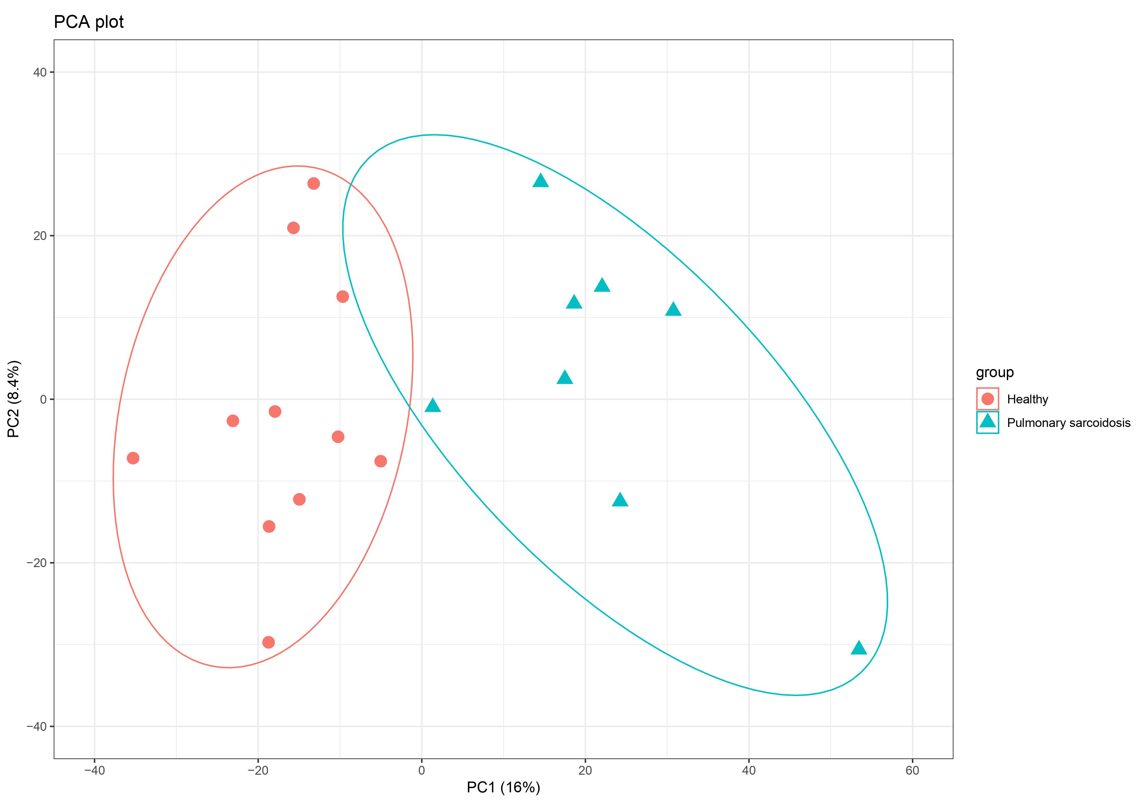
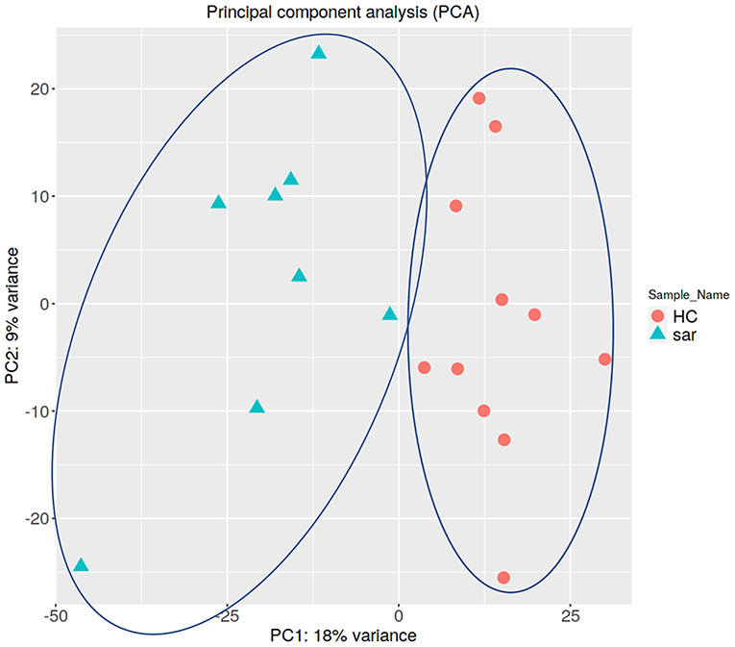
PCA PLOT
My plot
Plot from Literature

Slide 3
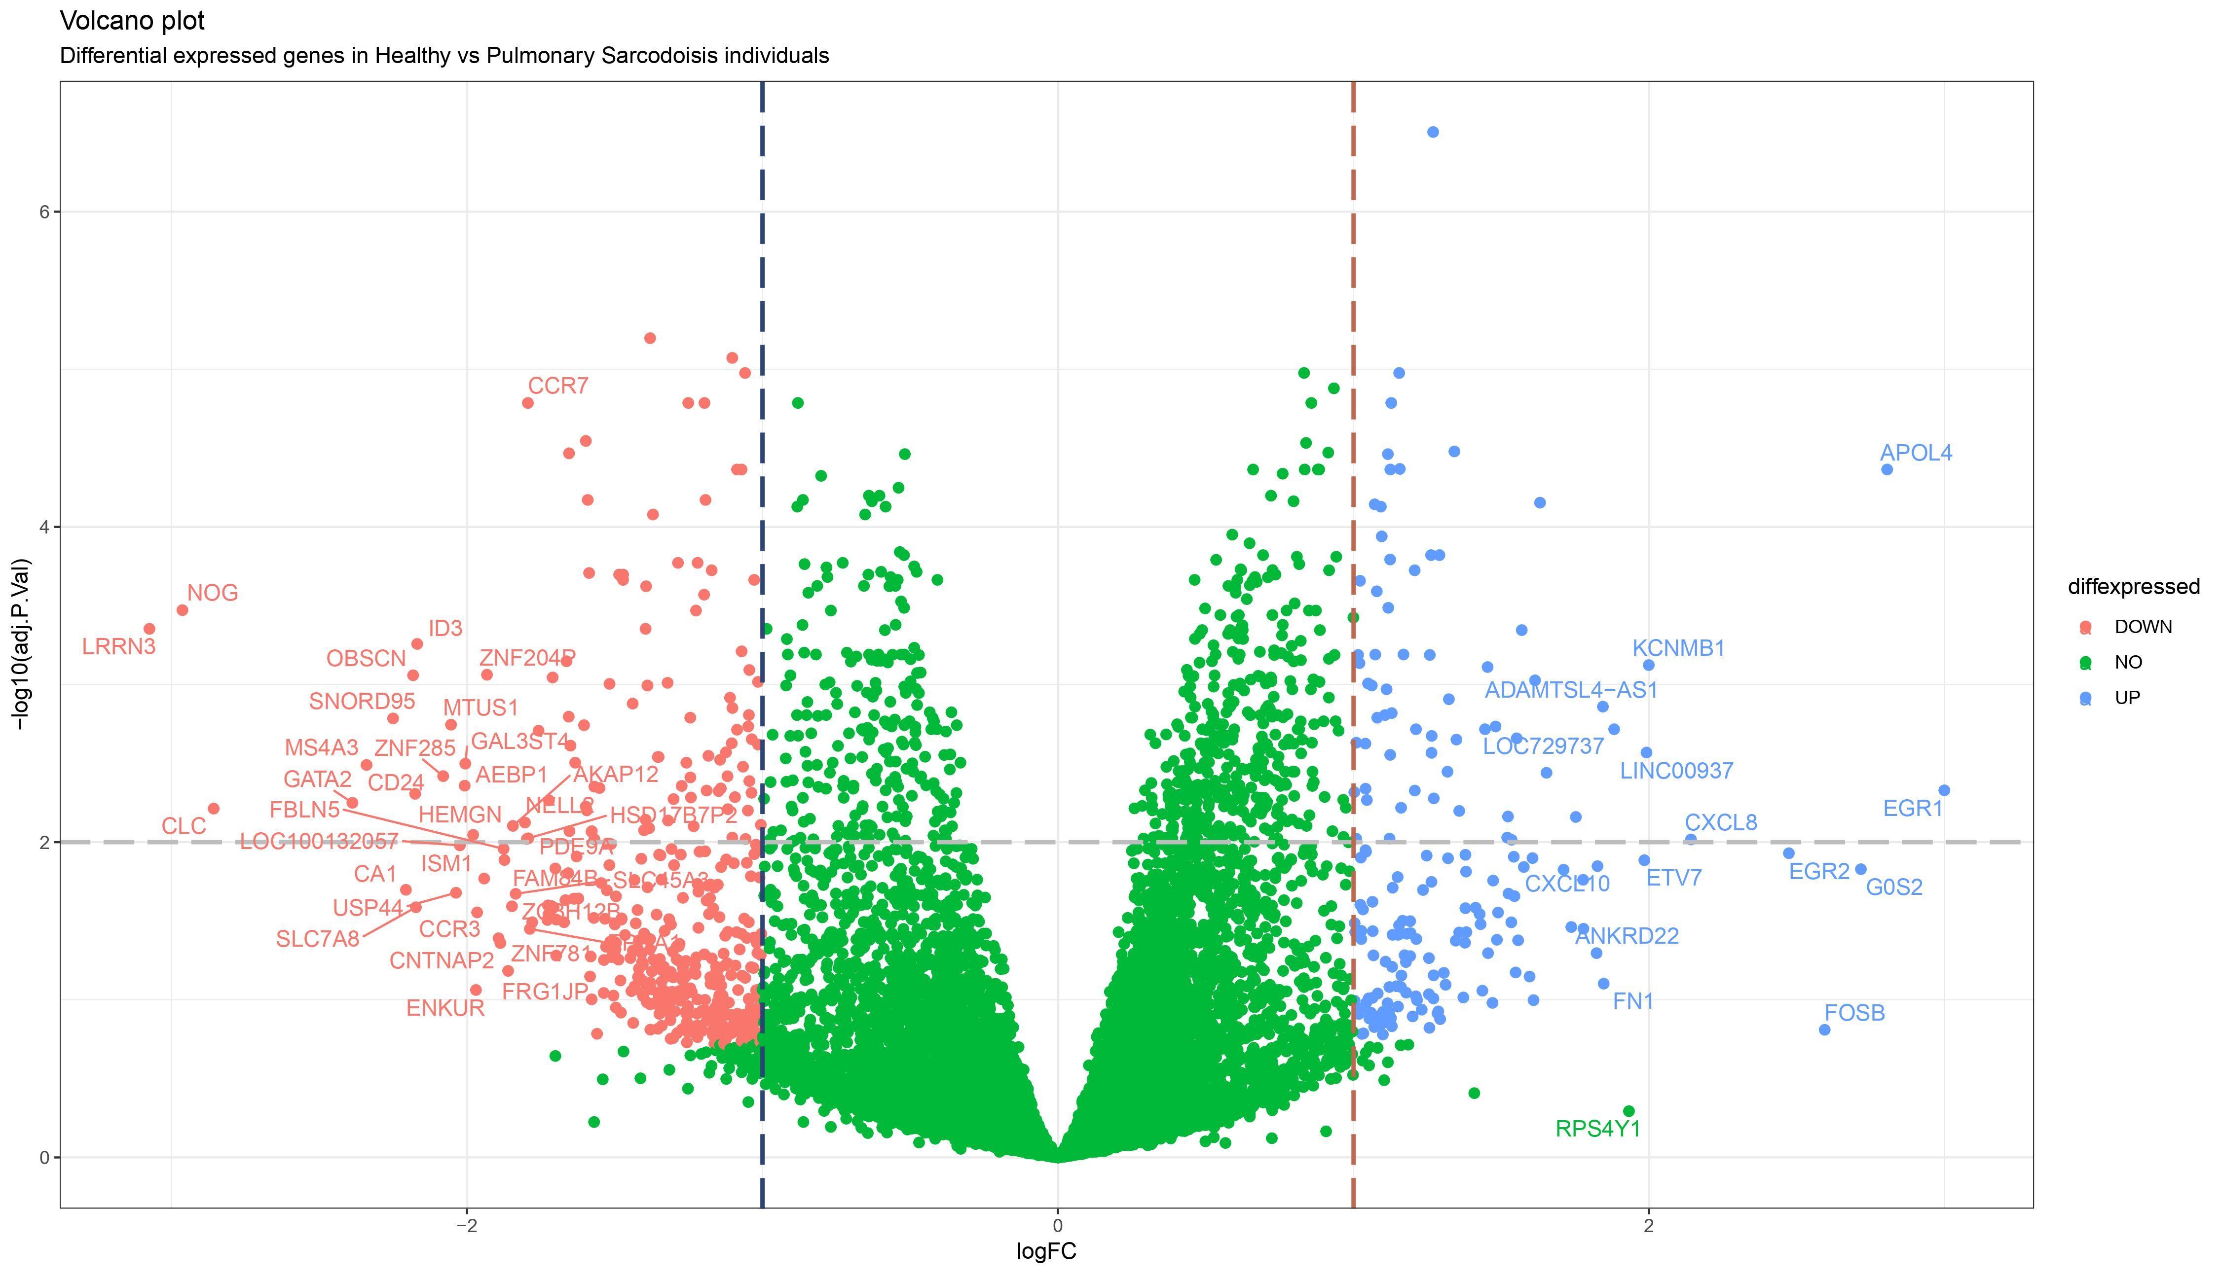
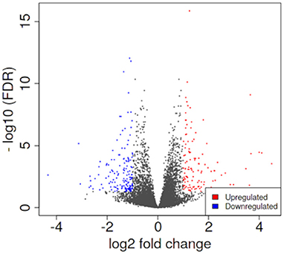
VOLCANO PLOT
My plot
Plot from Literature

Slide 4
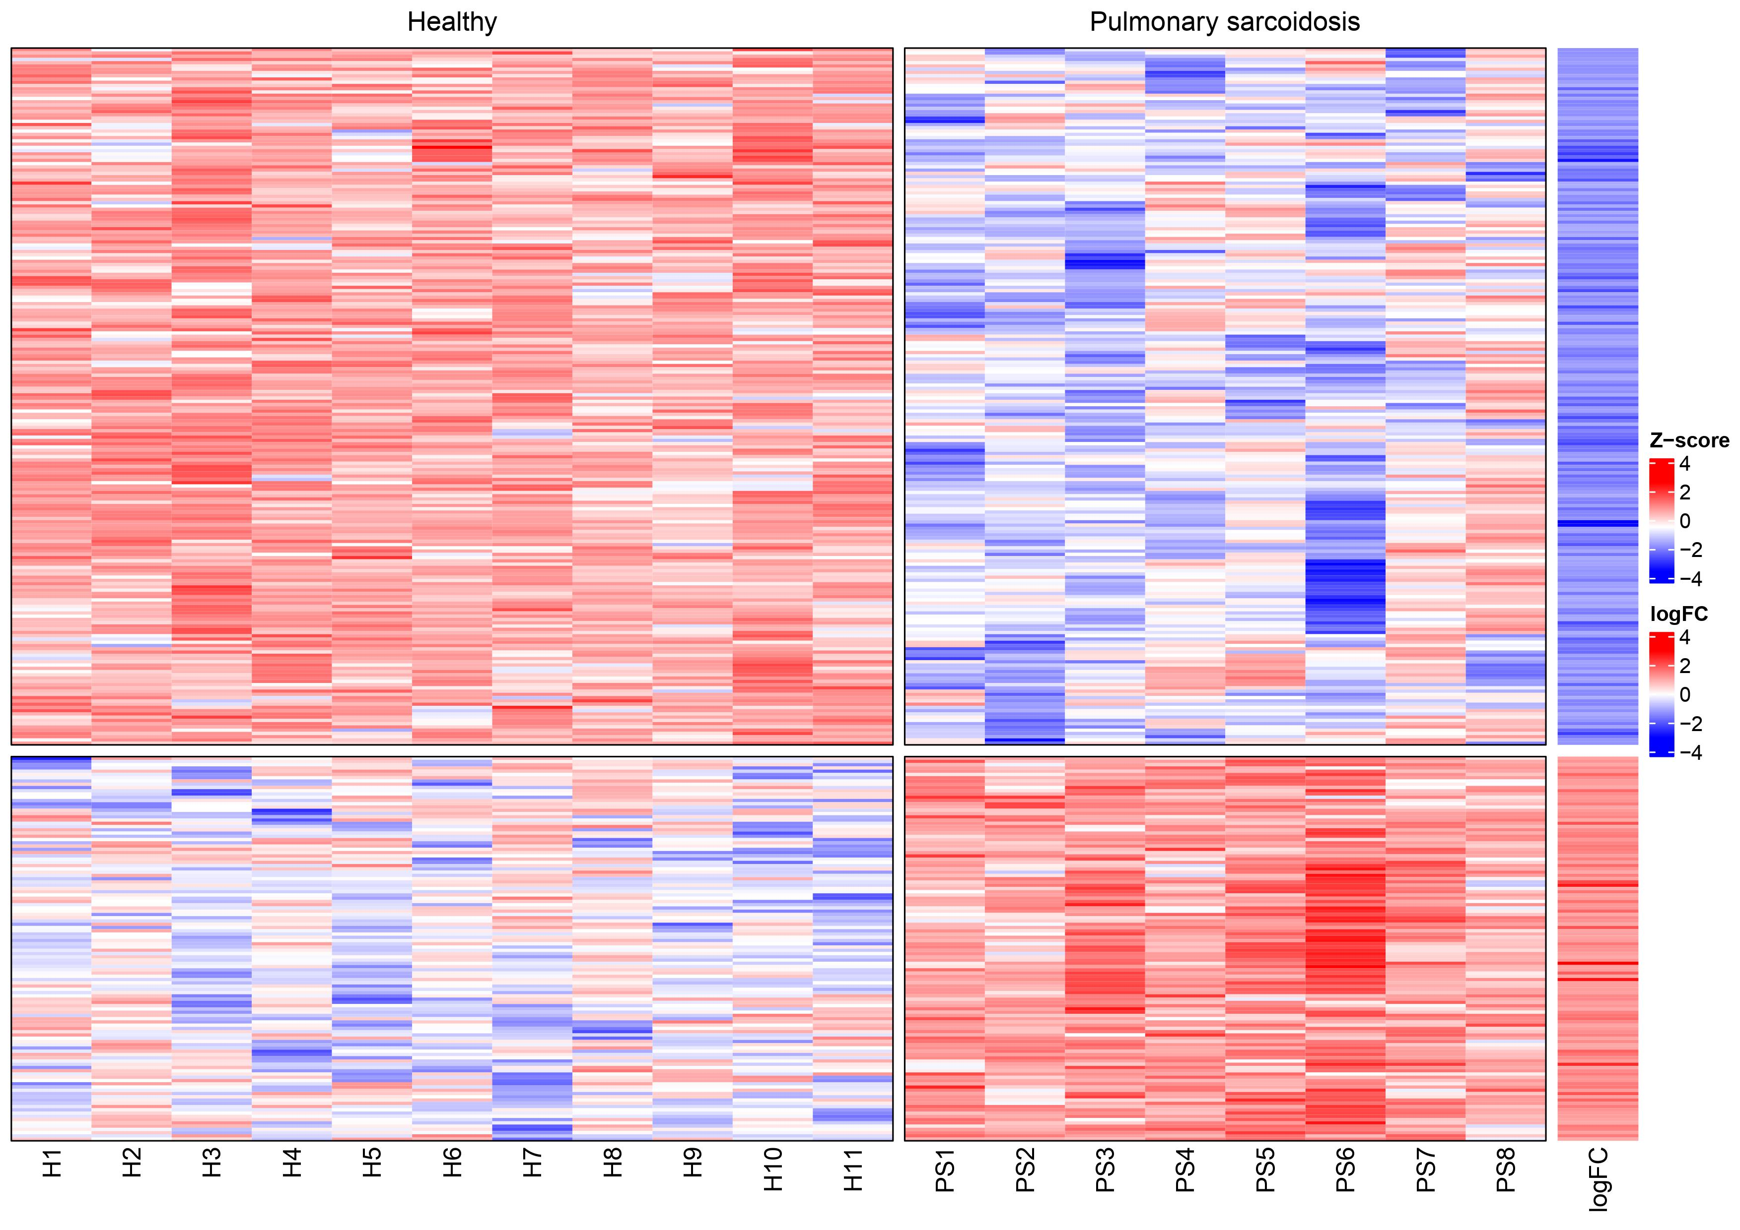
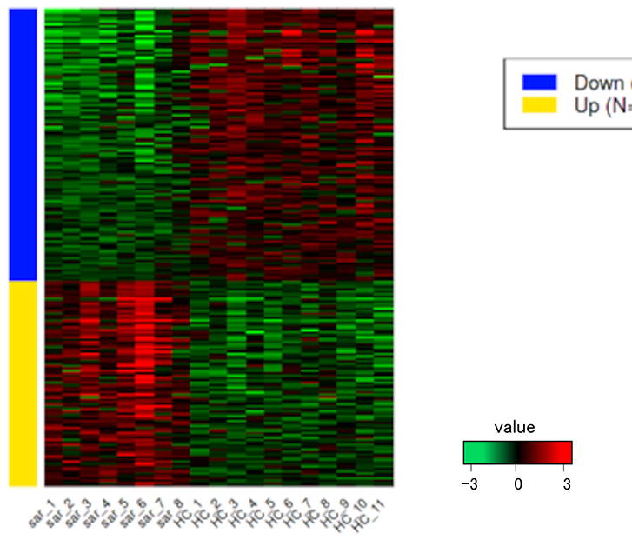

HEAT MAP
My plot
Plot from Literature

Slide 5
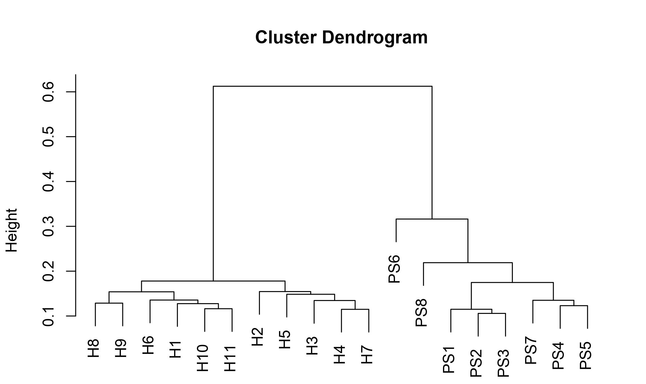
CLUSTER DENDROGRAM

Slide 6
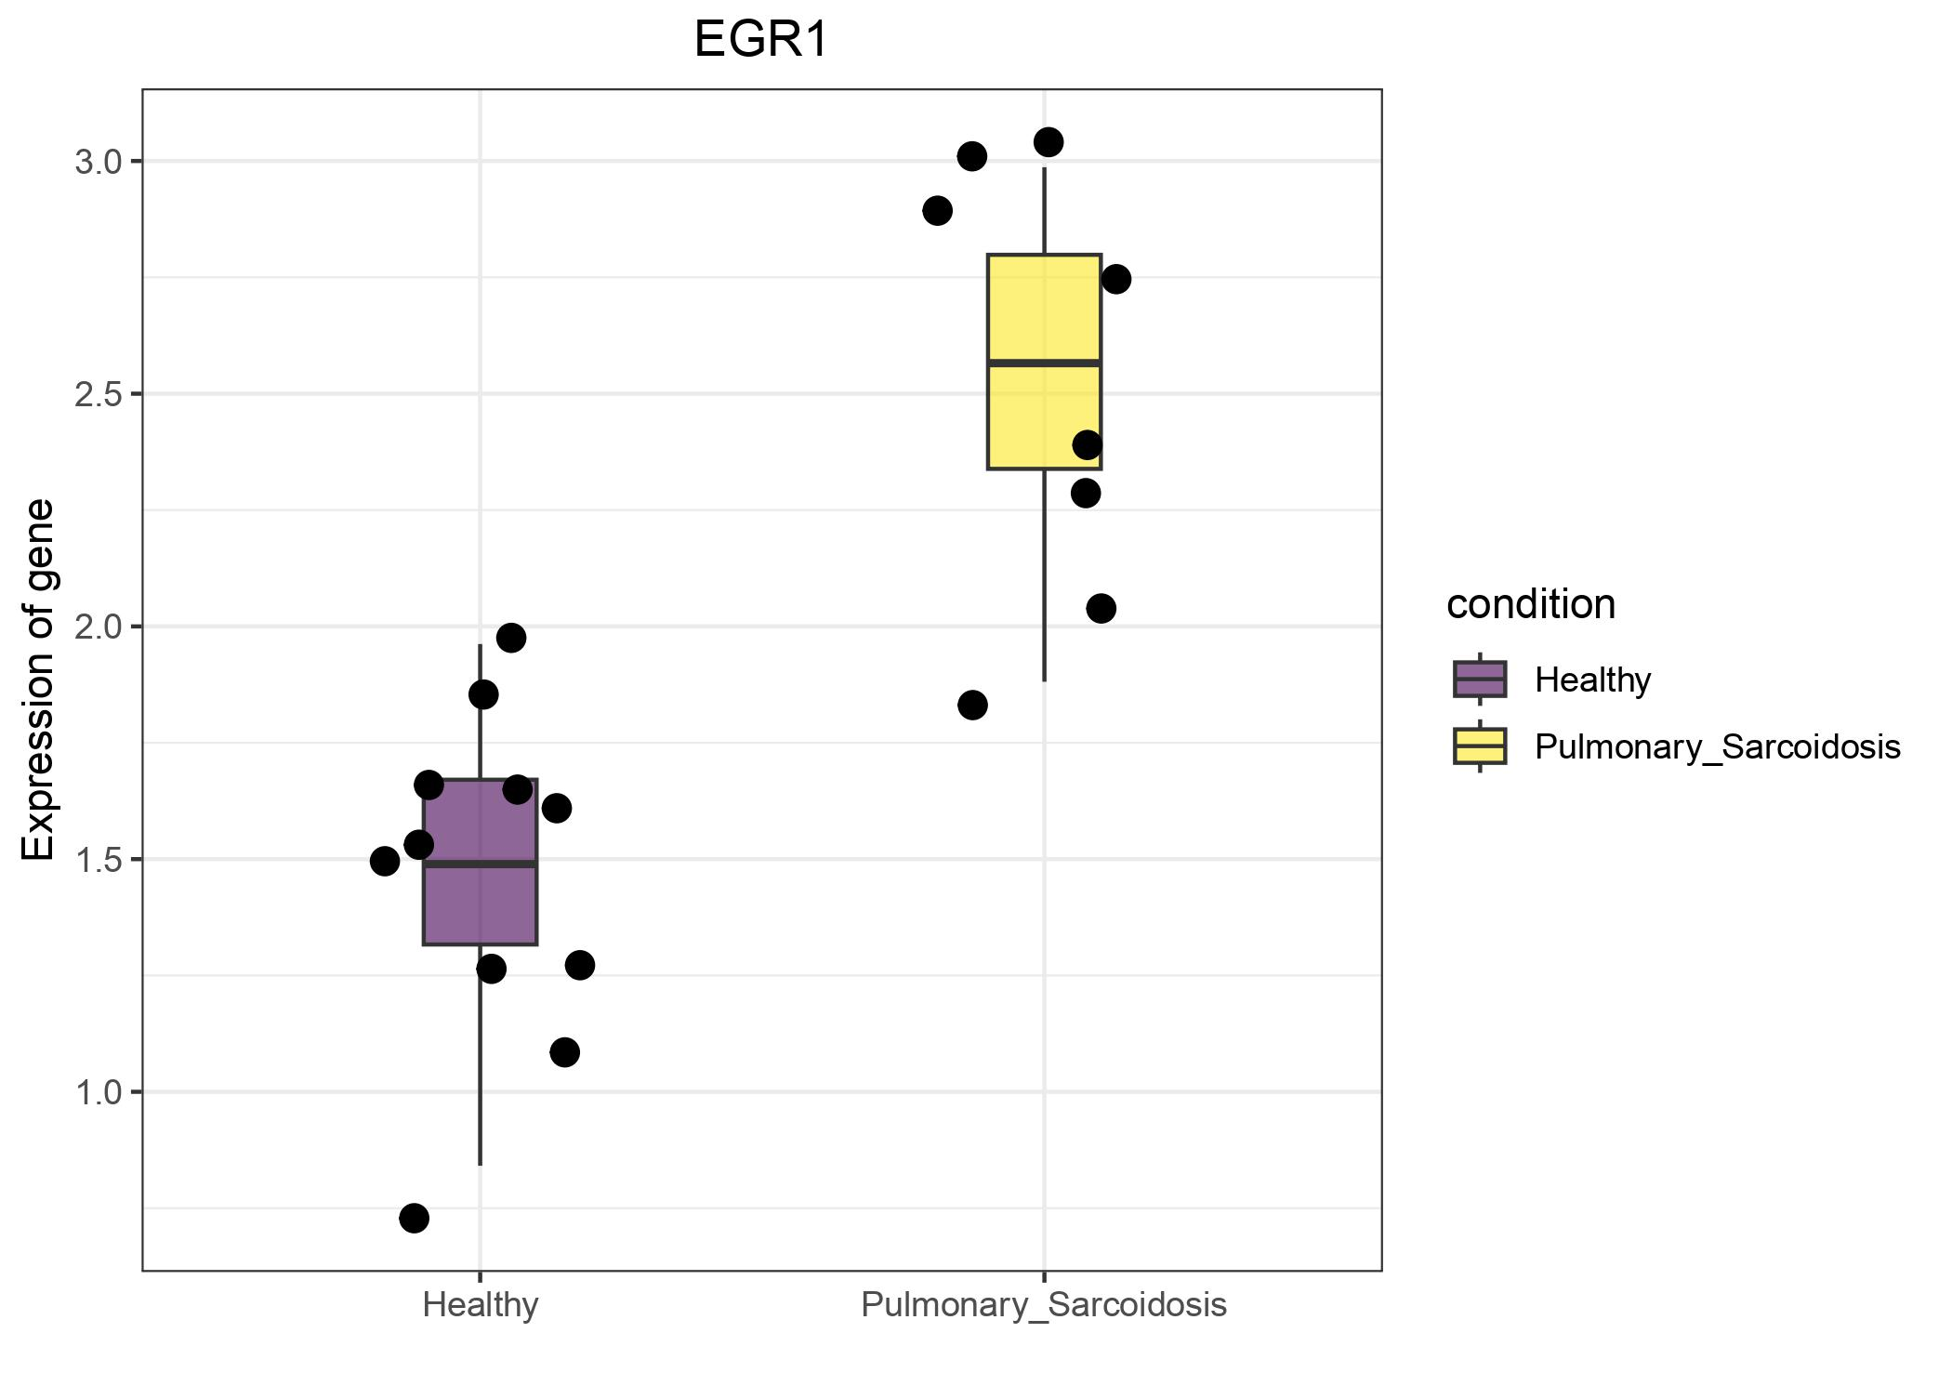
BOX PLOT OF DEG

Slide 7
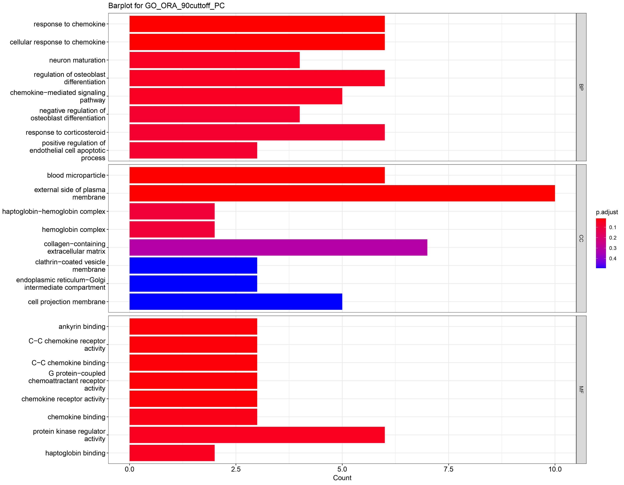
Gene Ontology Analysis

Slide 8
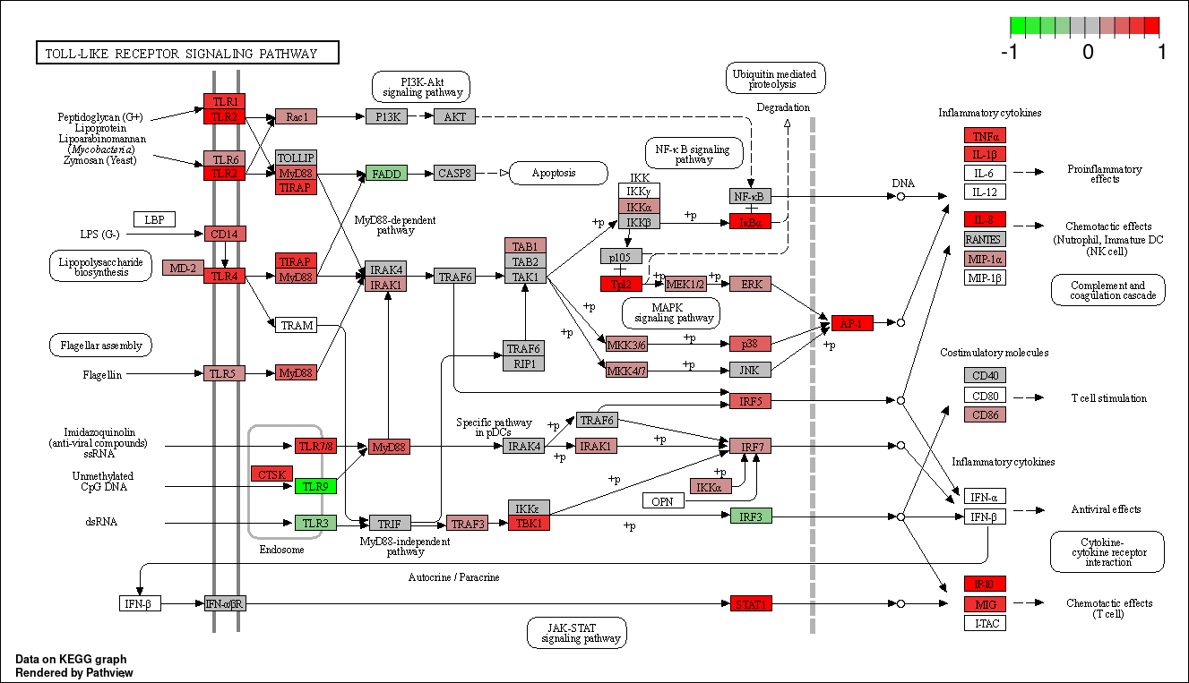
KEGG Pathway Analysis

Slide 9
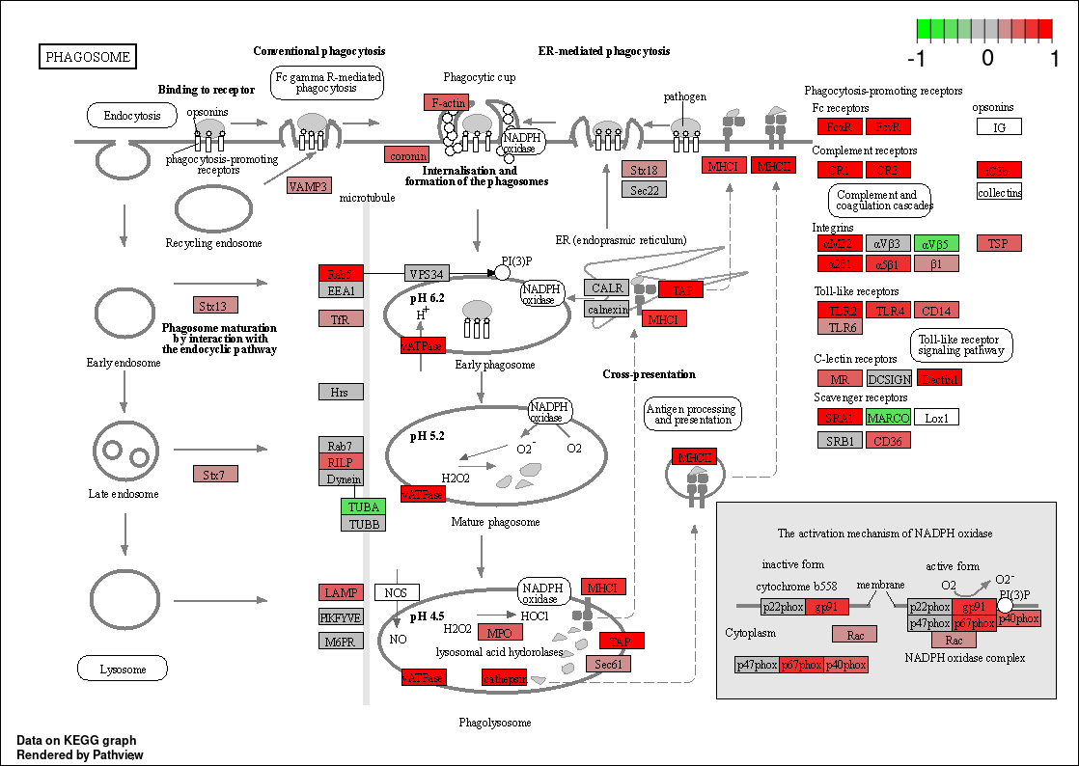

Slide 10
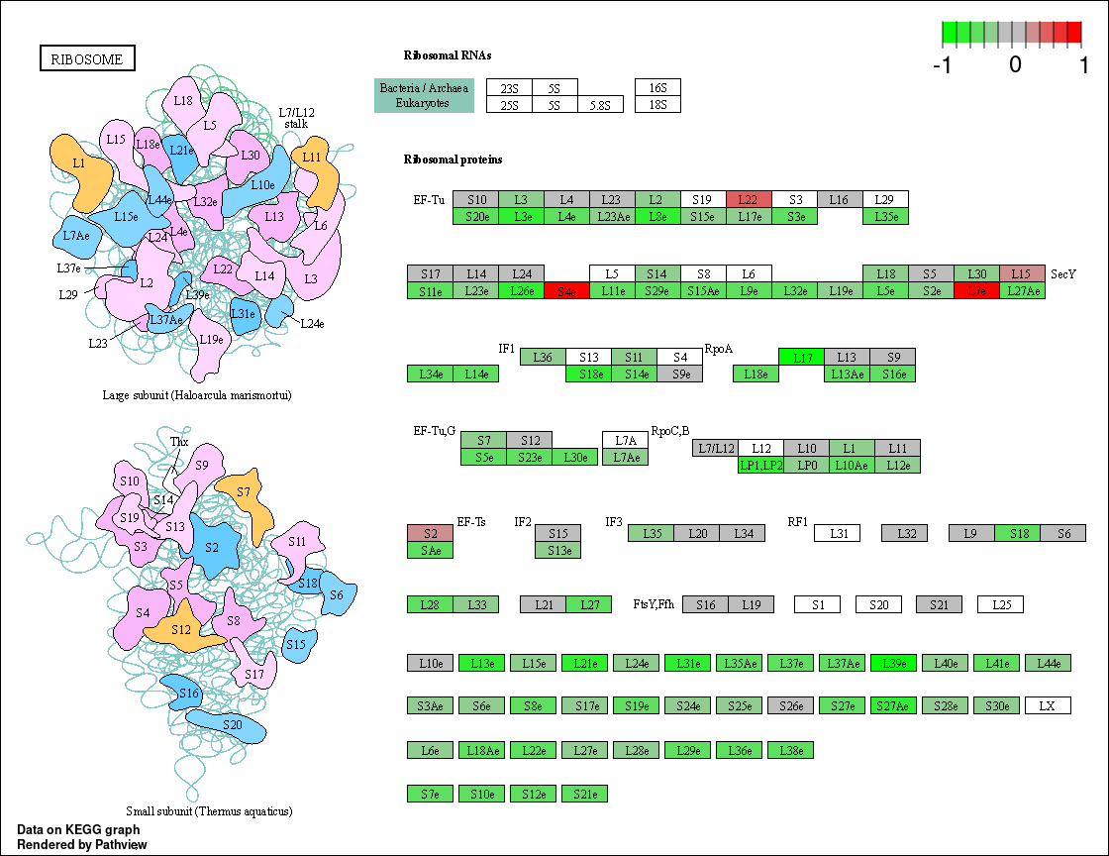

Slide 11
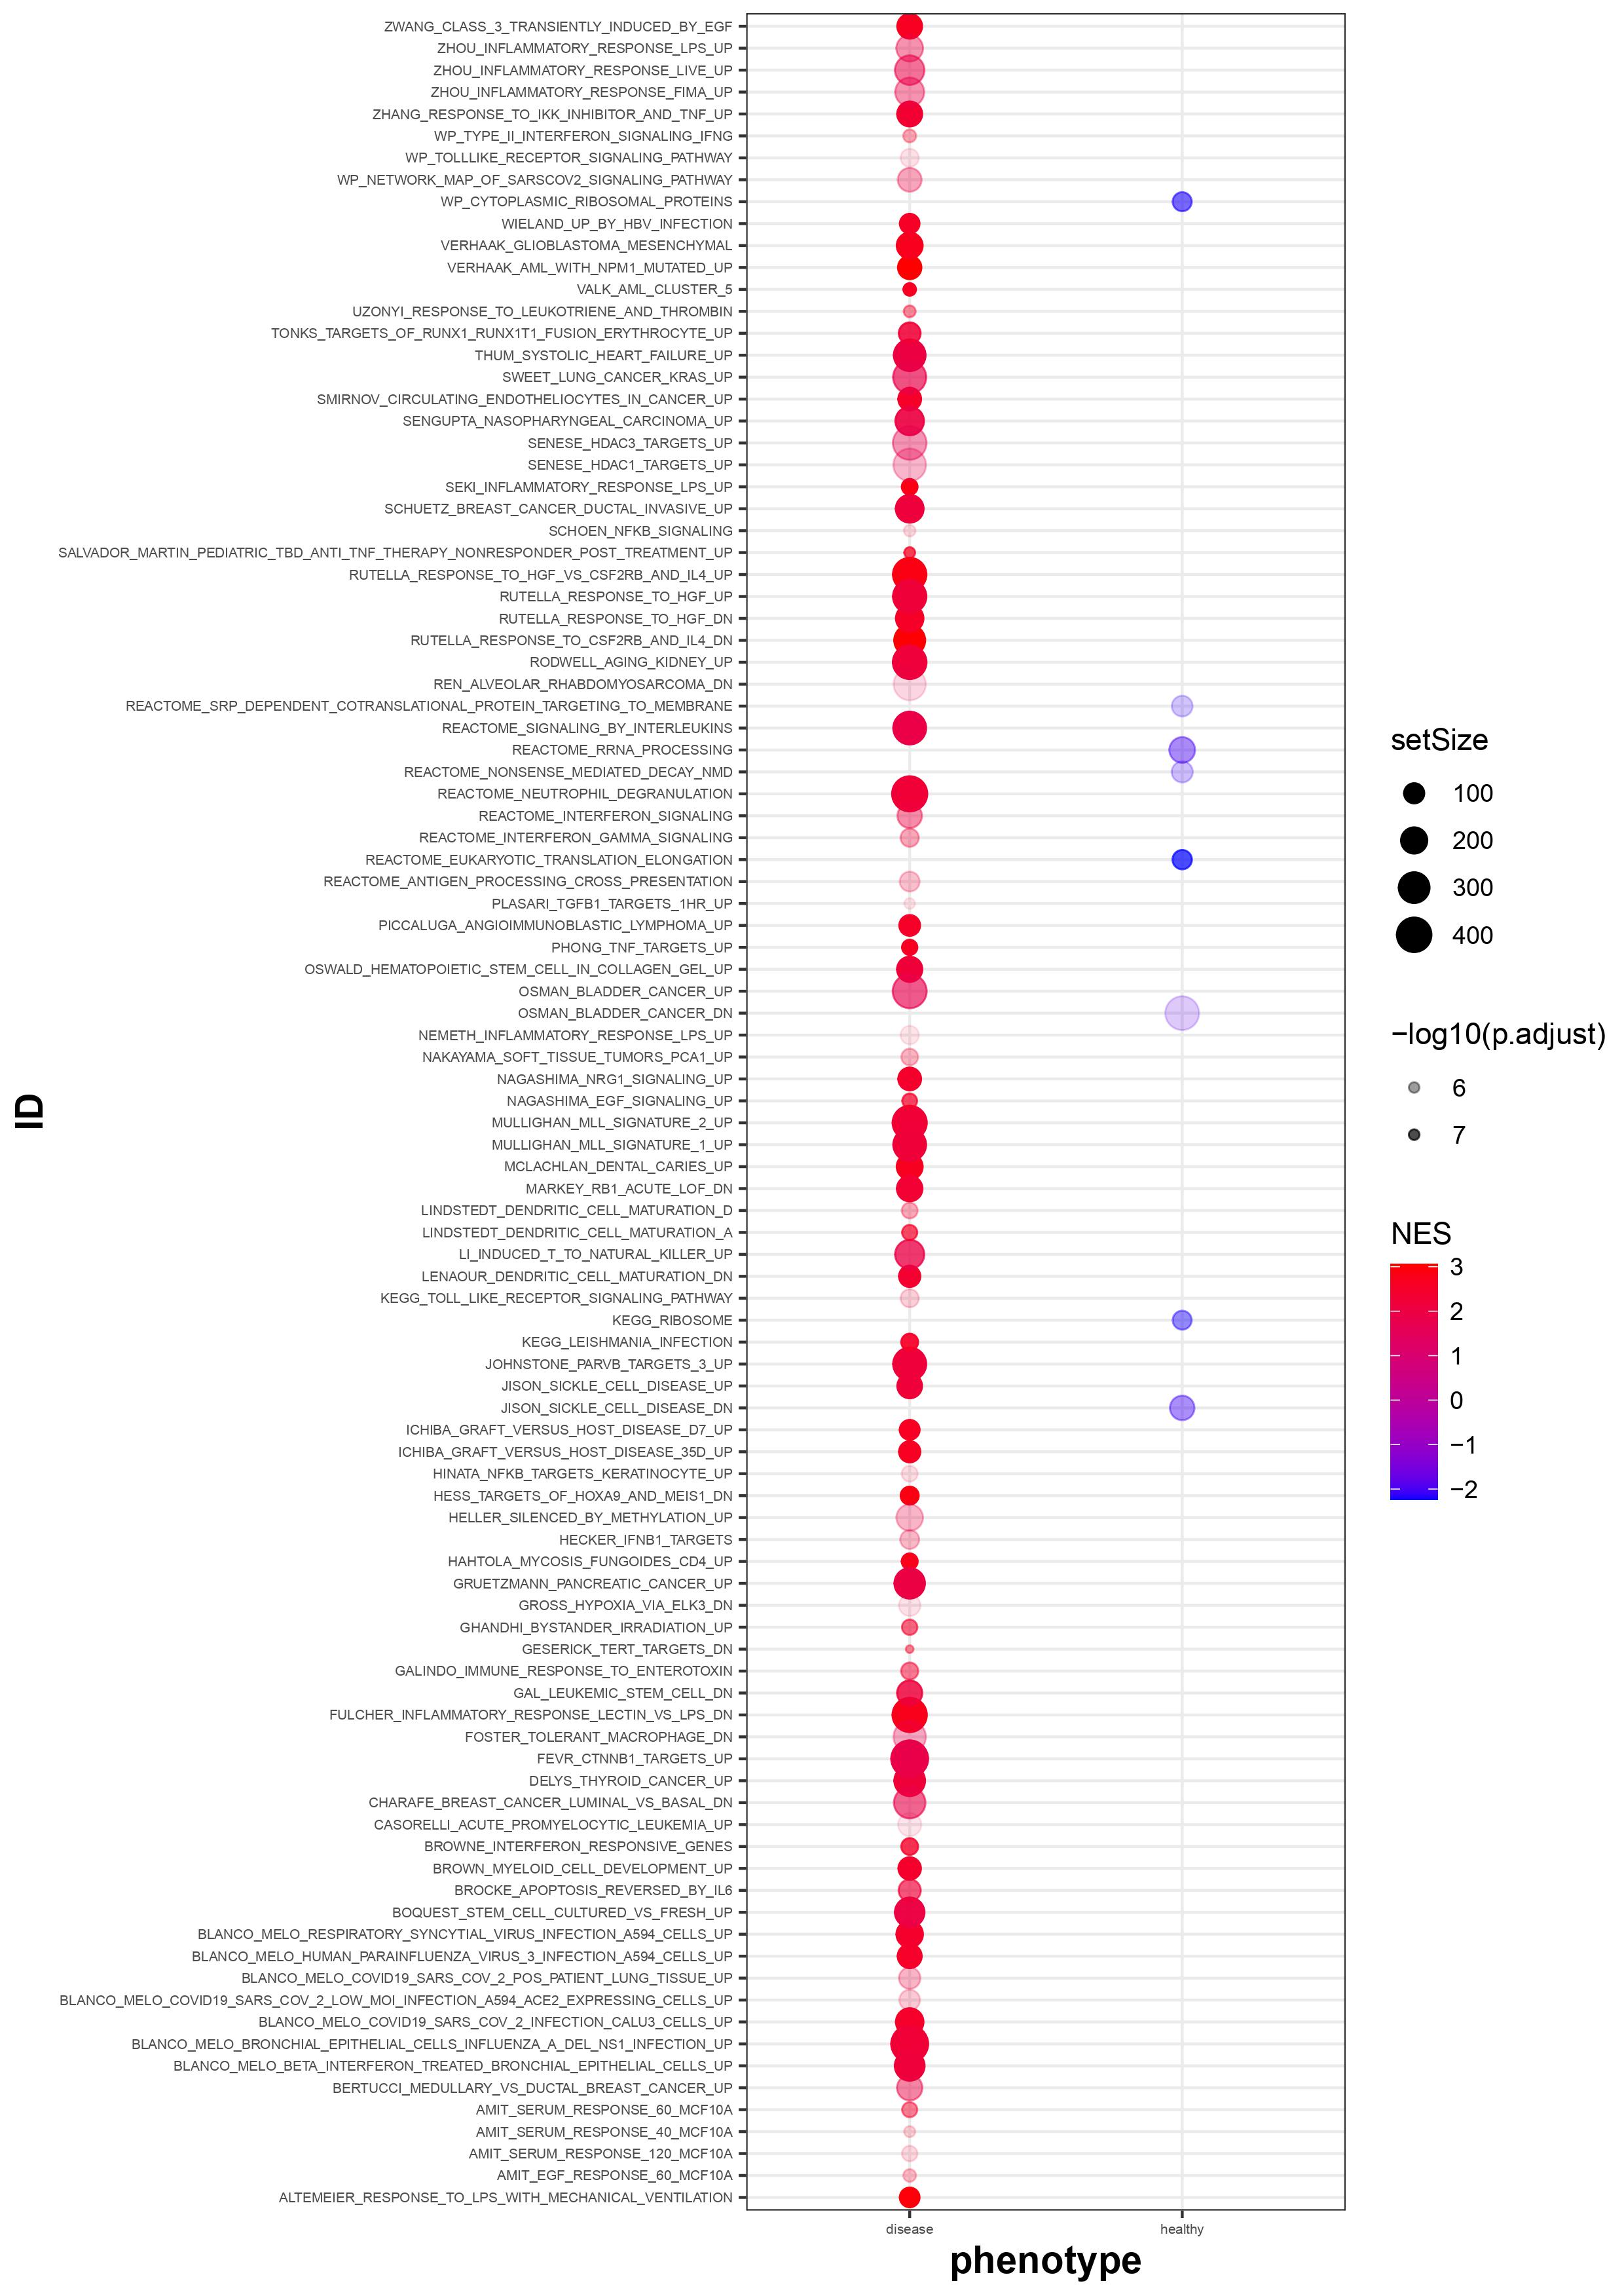
DOT PLOT OF GSEA RESULTS

Slide 12
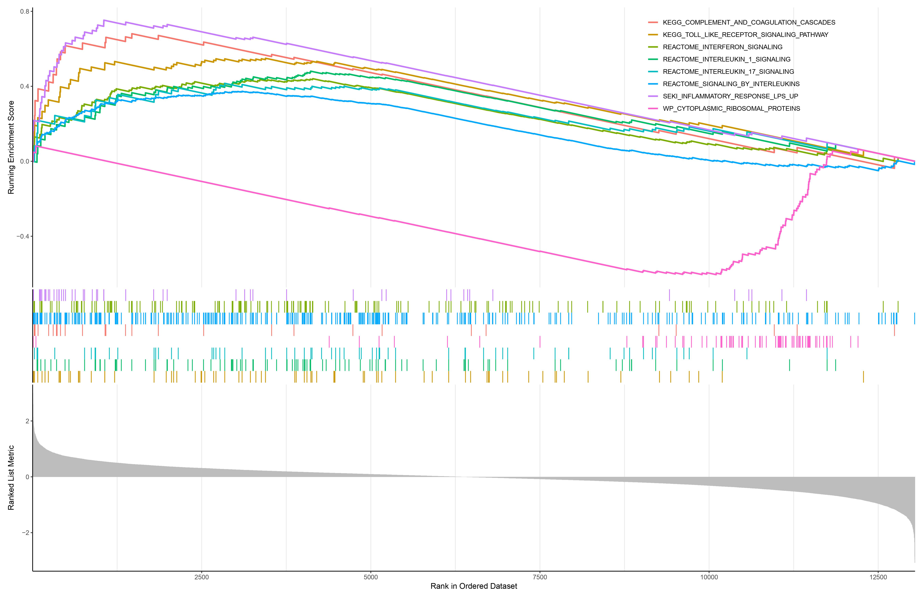
GSEA RESULTS

